Slide 1


Mathematical Application in Chemical Engineering
PROJECT-01
by Advay Shirwalkar
https://github.com/Advay2803/Math-Project

Slide 2
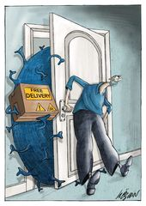
Introduction
ABOUT PROJECT
Studying the effect of population density and air quality index over number of COVID infected cases.
https://github.com/Advay2803/Math-Project

Slide 3
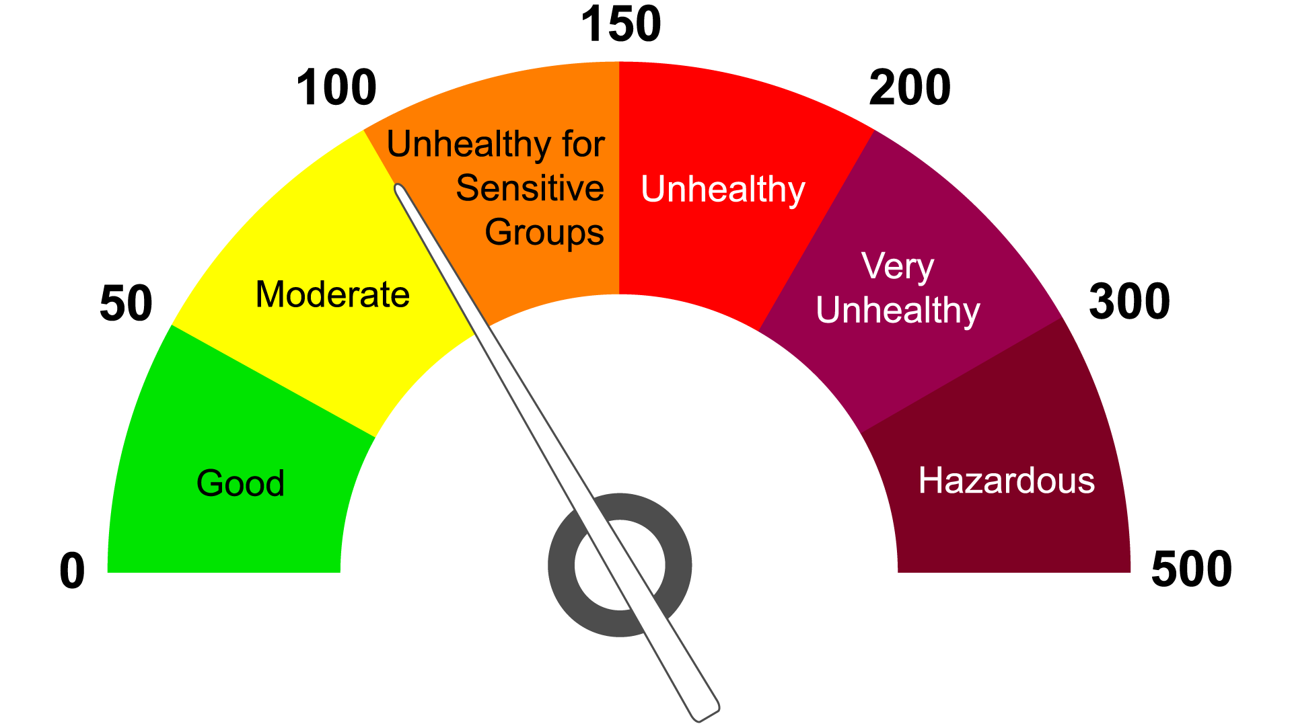
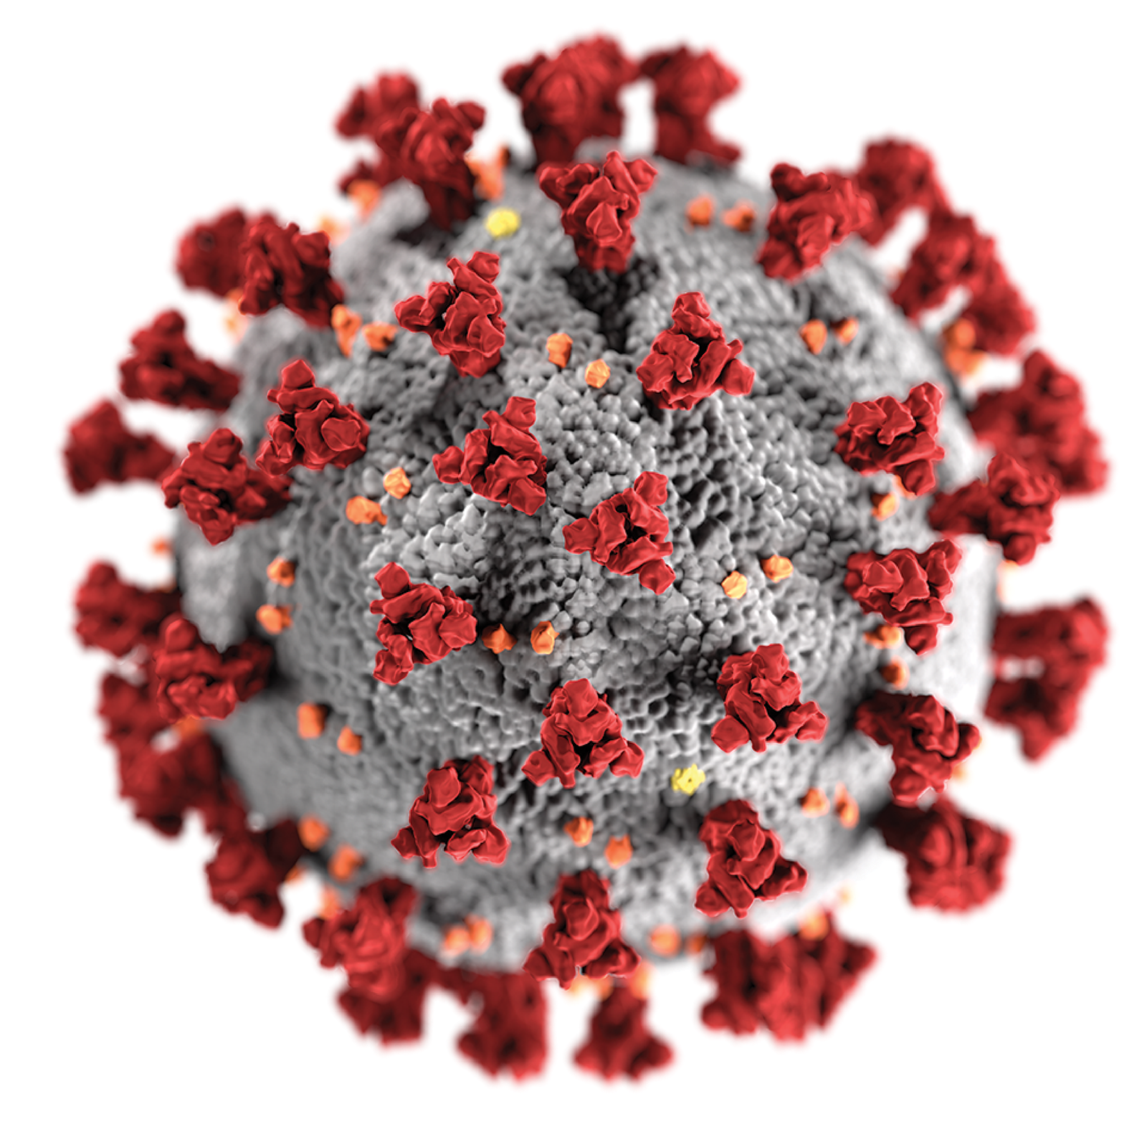

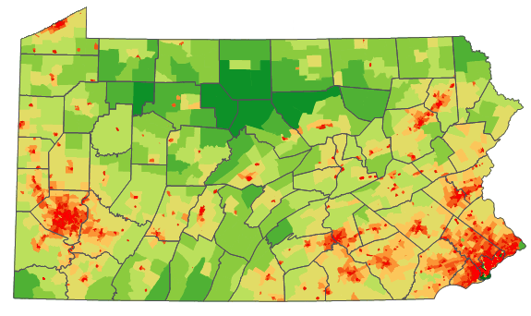
Central Idea
Air quality index
COVID-19 Infection
Total Infected people
Population Density
High Air quality index = weak lungs = Easily infected by COVID
High Population Density = Greater changes to infect with COVID
https://github.com/Advay2803/Math-Project

Slide 4
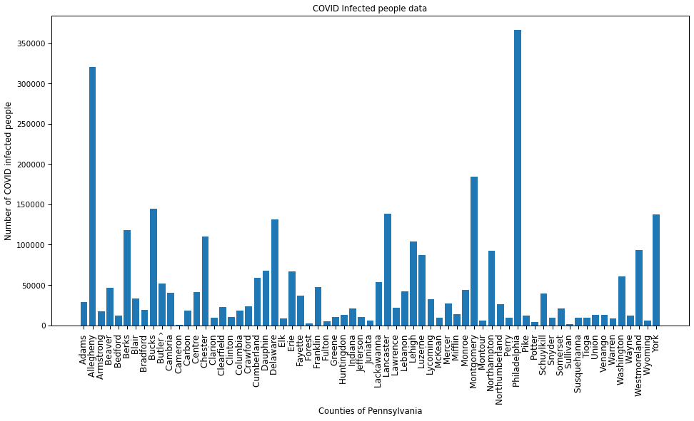
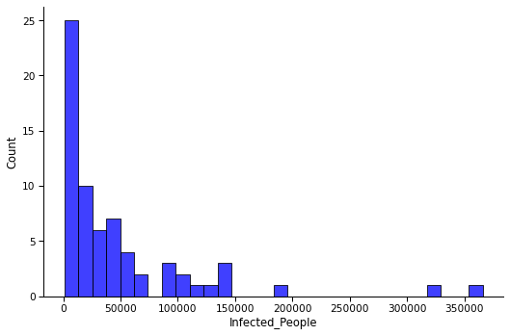
Total Number of COVID infected people
Distribution: Skewed on left
Most counties below 50000 individual cases.
https://github.com/Advay2803/Math-Project

Slide 5
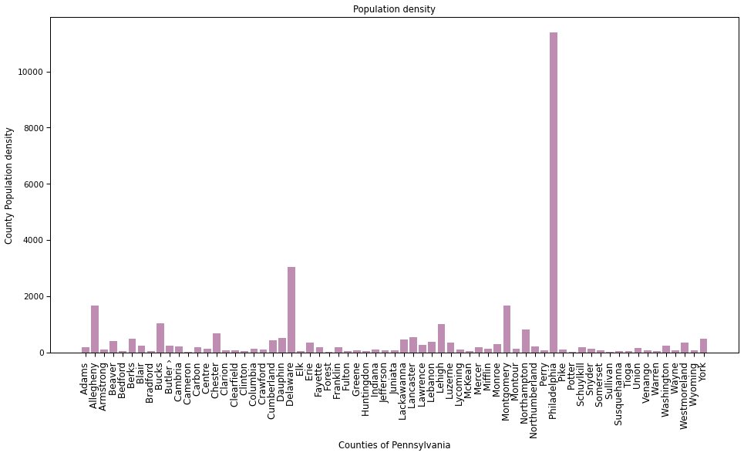
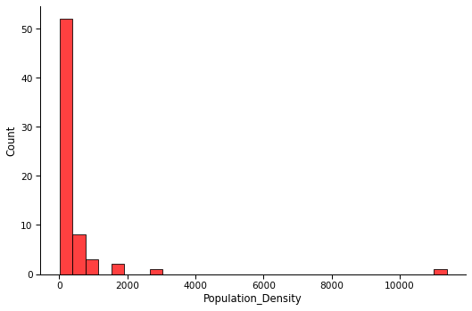
County-wise Population density
Distribution: Skewed on left
Most counties below 2000 individual cases.
https://github.com/Advay2803/Math-Project

Slide 6
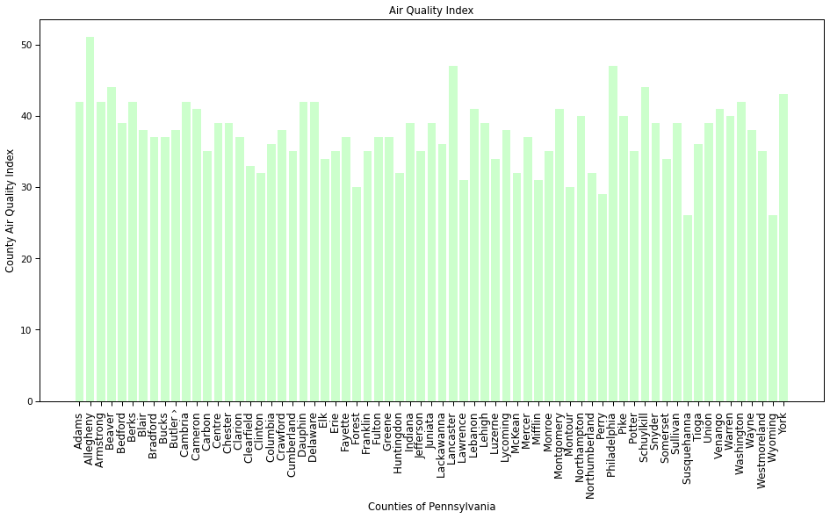
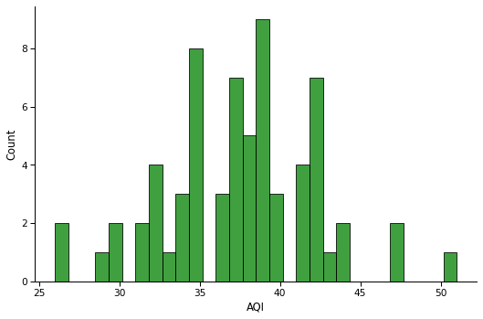
County-wise average Air Quality Index (AQI)
Distribution: Normally distributed to a great extent.
https://github.com/Advay2803/Math-Project

Slide 7
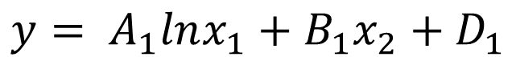
Mathematical Model
Without considering
interaction
With considering
interaction
Total Covid cases = A₁(log-PD) + B₁(AQI) + D₁
Total Covid cases = A₂(log-PD) +B₂(AQI) + C₂(log-PD x AQI)
+ D₂
$$y= A_{1}lnx_{1}+B_{1}x_{2}+D_{1}$$
$$y= A_{2}lnx_{1}+B_{2}x_{2}+C_{2}x_{2}lnx_{1}{+D}_{2}$$
https://github.com/Advay2803/Math-Project
**PD : Population Density
**AQI : Air Quality Index

Slide 8
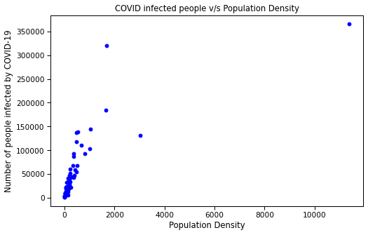
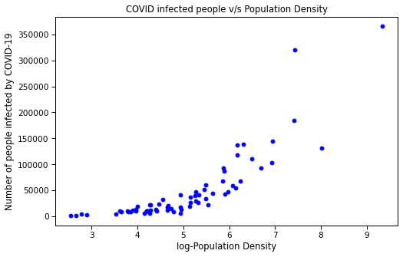
Logarithmic form v/s Normal form
Number of COVID cases (y) ∝ log-Population Density (ln(x₁))
Log form, improves linearity between the dependent and independent variables and boost the validity of statistical analysis.
https://github.com/Advay2803/Math-Project

Slide 9
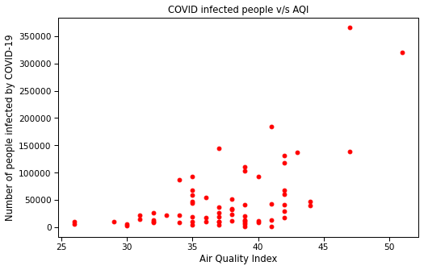
Effect of AQI on COVID cases
Number of COVID cases (y) ∝ Air Quality Index (x₂)
Many counties have similar AQI value but different COVID cases, this might be due to ease on lockdown restrictions, public gathering, etc
https://github.com/Advay2803/Math-Project

Slide 10
QUESTION 1
Does population density affect the COVID infection?
Hypothesis: For people living in county with higher population density have higher chances of getting COVID cases.
Since, the data is skewed, we use U-test.
From the python code, p-value = 0.99999
Thus, our hypothesis is correct that for people living in county with higher population density have higher chances of getting COVID cases.
https://github.com/Advay2803/Math-Project

Slide 11
QUESTION 2
Does the AQI affect the COVID cases?
Hypothesis: For people living in county with higher Air quality index have higher chances of getting COVID cases.
From the python code, p-value = 0.74576
Thus, our hypothesis is almost correct that for people living in county with higher population density have higher chances of getting COVID cases.
This might be because of few factors like:
Incorrect measurement and monitoring of AQI in the county region.
Higher winding flowing in most of the days, thus resulting in lower overall AQI values.
https://github.com/Advay2803/Math-Project

Slide 12
QUESTION 3
What is the combine effect of AQI and Population Density on COVID cases?
Hypothesis: For people living in county with higher population density and higher AQI have higher chances of getting COVID cases.
This, is determined by the Regression Analysis.
For the non-interacting parameter model,
A₁ = 34215.393 , B₁ = 3197.946 , D₁ = - 225996.081
y = 34215.393*ln(x₁) + 3197.946*x₂ - 225996.081
Thus, the hypothesis is CORRECT.
https://github.com/Advay2803/Math-Project

Slide 13
QUESTION 4
How does the interaction of parameter affect?
Hypothesis: The greater interaction between the parameter would result in higher COVID cases.
This, is determined by the Regression Analysis.
For the non-interacting parameter model,
A₁ = 34215.393 , B₁ = 3197.946 , D₁ = - 225996.081
y = -34067.203 ln(x₁) - 6274.622*x₂ + 1863.915* ln(x₁) * x₂ + 80731.491
Thus, the hypothesis is CORRECT.
https://github.com/Advay2803/Math-Project

Slide 14
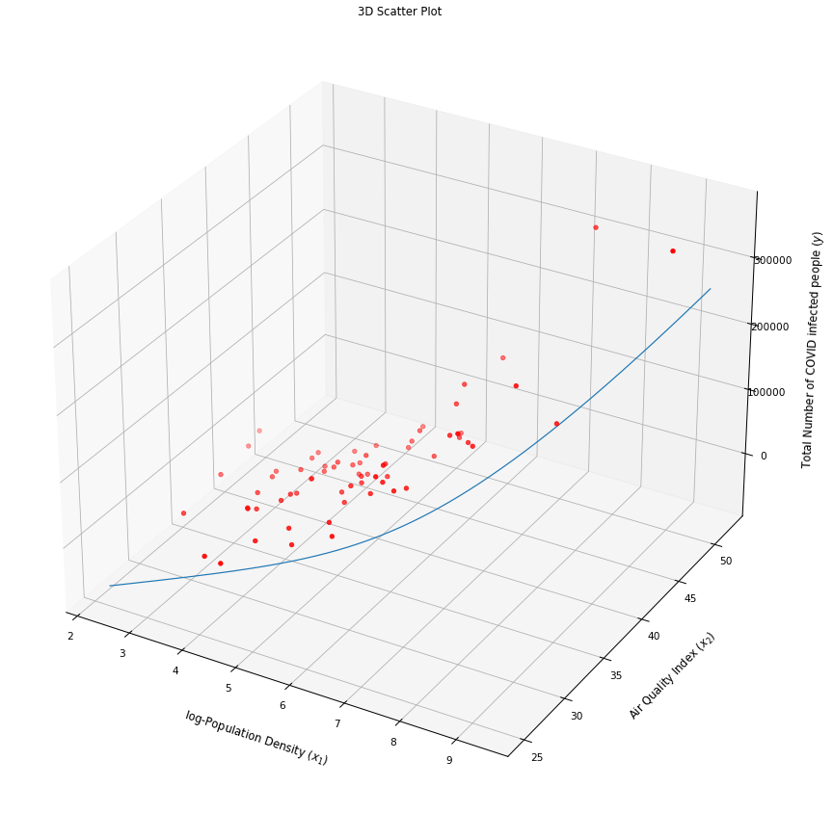

Results
Without considering interaction
With considering interaction

Slide 15
QUESTIONS?
https://github.com/Advay2803/Math-Project

Slide 16

THANK YOU
ads288@pitt.edu
https://github.com/Advay2803/Math-Project

